Slide 1

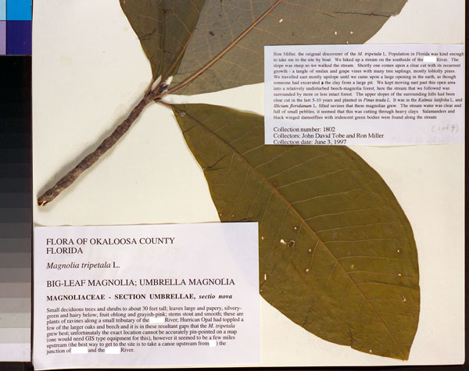
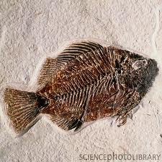
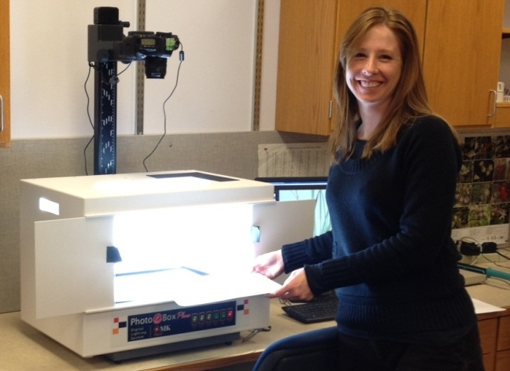
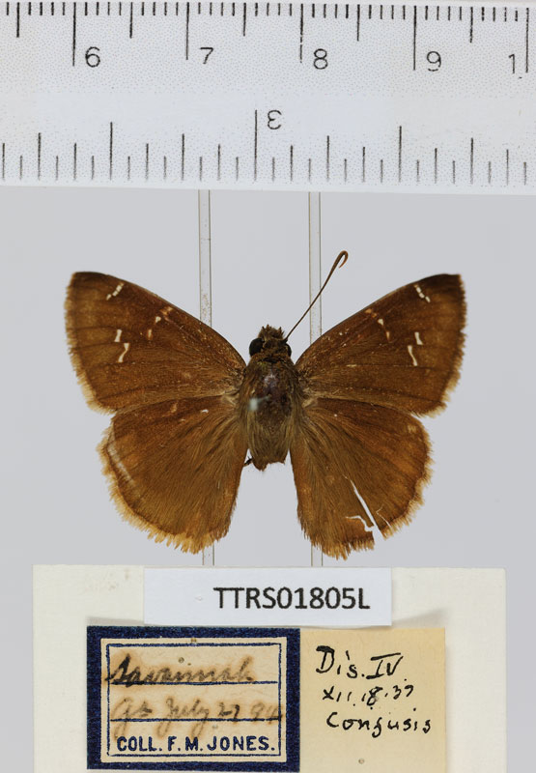
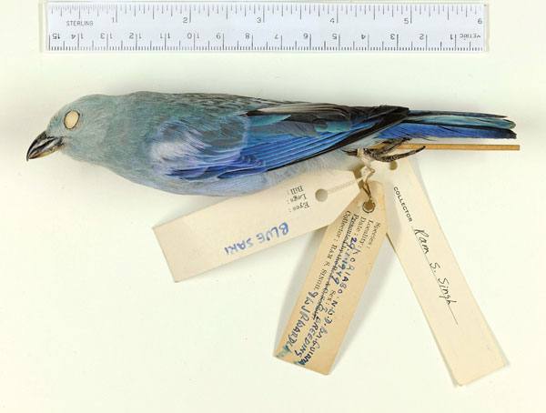
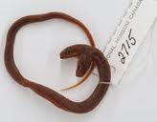
iDigBio Cloud and Appliances: Concept, Processes and Progress
Jose Fortes
(on behalf of the iDigBio IT team)

Slide 2
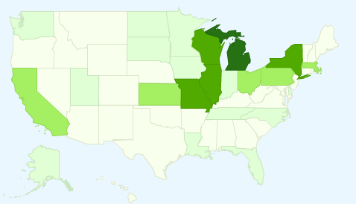
iDigBio (idigbio.org)
Goal: making data and images for millions of biological specimens available in electronic format for the biological research community, agencies, students, educators, and public
Mission: leadership, coordination, and outreach in digitization of collections by implementing resources for communication, use of technology, access to data, research and education.
A resource: permanent cloud computing infrastructure
to link biological data from collections across the USA
to use search and analytics tools to mine and reference data
Notes:
ADBC – Advancing Digitization of Biological Collections
Search and analytics tools will enable anyone to mine and reference diverse data, such as taxonomy, geographic location, 2- and 3-dimensional images, vocalizations, and molecular resources, which are tied to specific specimens. These data promote integrative biological research on living and fossil species, and provide an immense resource for agricultural sciences, land use management, assessing the impacts of climate change, invasive species, and other natural resource management issues.

Slide 3

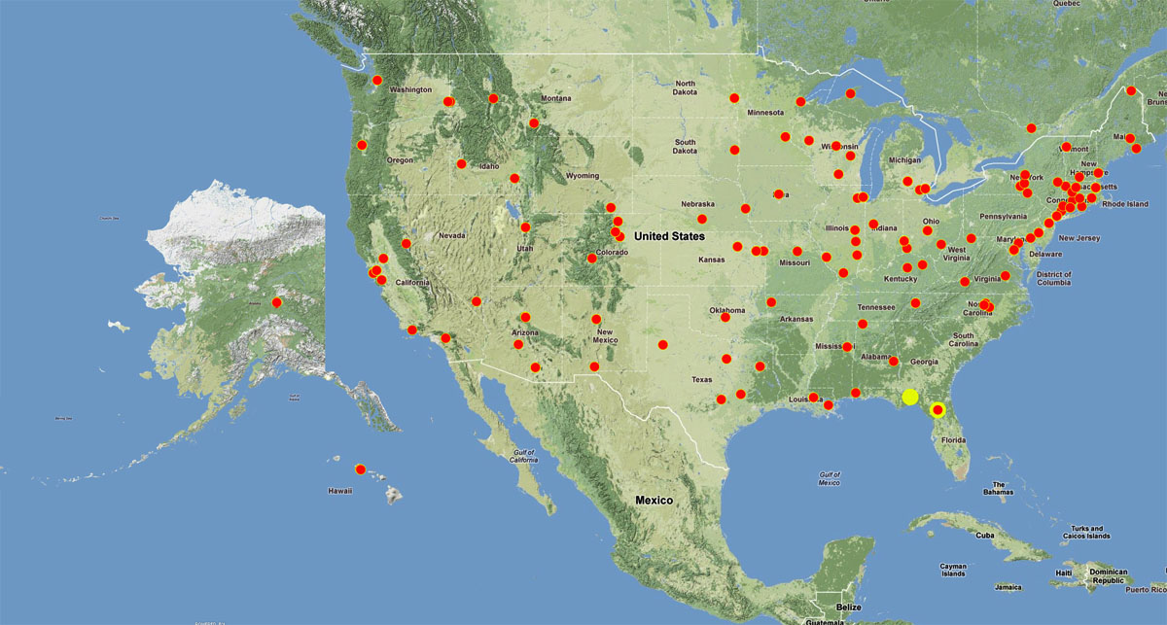
Seven Thematic Collections Networks (TCNs)
InvertNet: An Integrative Platform for Research on Environmental Change, Species Discovery and
Identification (Illinois Natural History Survey, University of Illinois) invertnet.org
Plants, Herbivores, and Parasitoids: A Model System for the Study of Tri-Trophic Associations (American Museum of Natural History) tcn.amnh.org
North American Lichens and Bryophytes: Sensitive Indicators of Environmental Quality and Change (U of Wisconsin) symbiota.org/nalichens/index.php symbiota.org/bryophytes/index.php
Digitizing Fossils to Enable New Syntheses in Biogeography-Creating a PALEONICHES-TCN (U of Kansas)
The Macrofungi Collection Consortium: Unlocking a Biodiversity Resource for Understanding Biotic Interactions, Nutrient Cycling and Human Affairs (New York Botanical Garden)
Mobilizing New England Vascular Plant Specimen Data to Track Environmental Change (Yale University)
Southwest Collections of Anthropods Network (SCAN): A Model for Collections Digitization to Promote Taxonomic and Ecological Research (Northern Arizona University)
http://hasbrouck.asu.edu/symbiota/portal/index.php
More than 130 participating institutions

Slide 4
iDigBio IT Vision
Cyberinfrastructure to enable
the collaborative creation, integration and management of digitized biocollections, and
their use in scientific research, education and outreach.
Visible as a collection of persistent Internet-accessible services, data and resources for
biocollection “producers”, “consumers” and “service providers”
cyberinfrastructure providers
national/global data aggregators

Slide 5
CI Stakeholders
TCNs
Domain Data Producers
Infrastructure Providers
Domain Service Providers
Domain Data Consumers
National/Global Data Aggregators
Museums
Collectors
Amazon Turk
GBIF
iPlant
Amazon WS
Domain-level data
ALA
Google
iDigBio
DataONE
EOL
TCNs
BISON
Microsoft Azure
Data Conservancy
Georeferencing
Researchers
Teachers
Imaging services
Citizens
Data quality
NESCent
TCNs
Translation
Mapping
TCNs
OCR
Government
iPlant
Notes:
This diagram presents the stakeholders listed in the previous slide that will form the iDigBio cloud and that are distinct from a CI point of view.
Representative projects, industry and organizations of each group are shown around each rounded-box, and one can have multiple “hats”.
For example, a TCN will certainly be a biocollections data producer, would also likely be a consumer of this data, and could potentially offer biocollections-specific services or provide cyberinfrastructure for the iDigBio cloud.

Slide 6
Evolution of iDigBio capabilities
Data ingestion
Data access, provision and visualization
Provide and enable data feedback
Data linking and federation
Process and visualize integrated data
Time
Increasing storage and server hosting in support of the above
Increasing number of appliances in support of the above
Web site for interaction with public, community, education and above

Slide 7
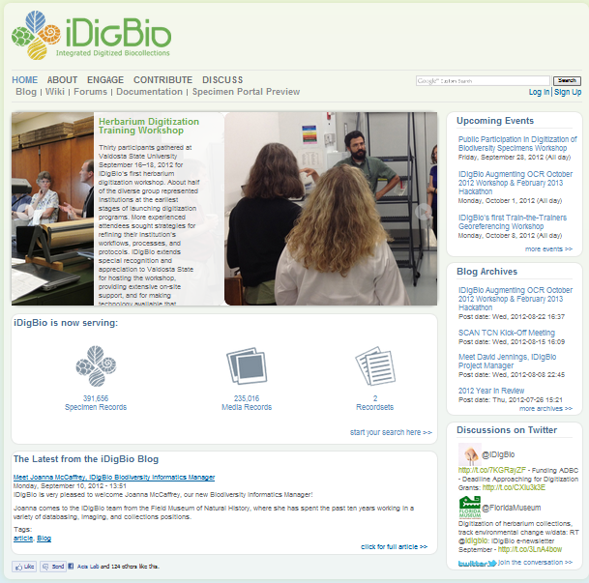
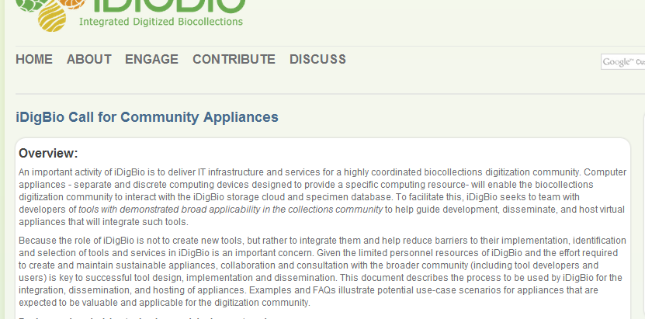
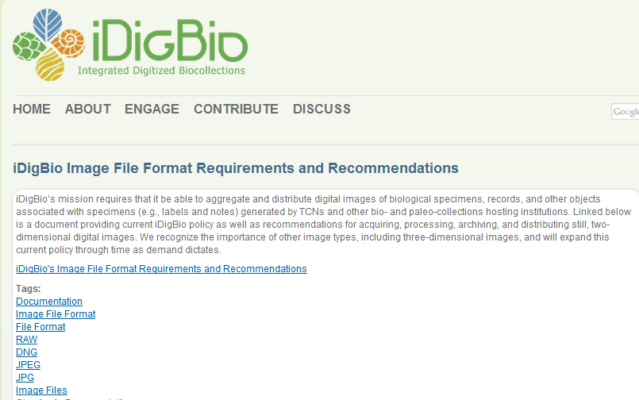
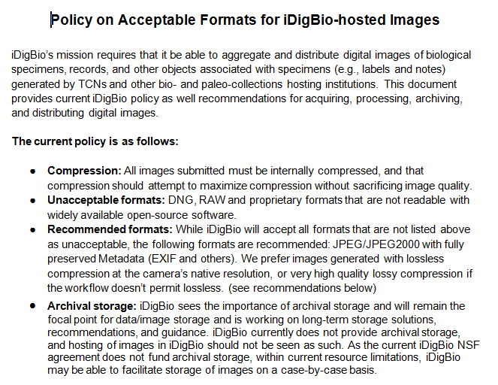
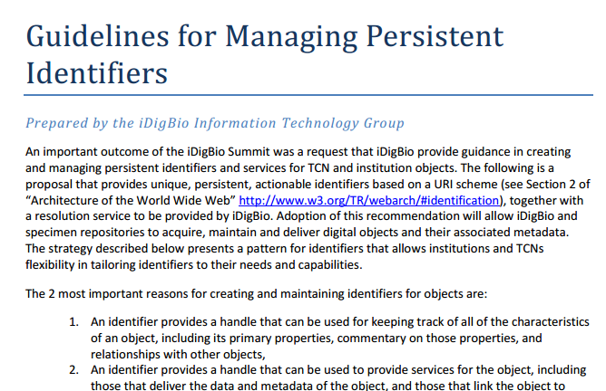
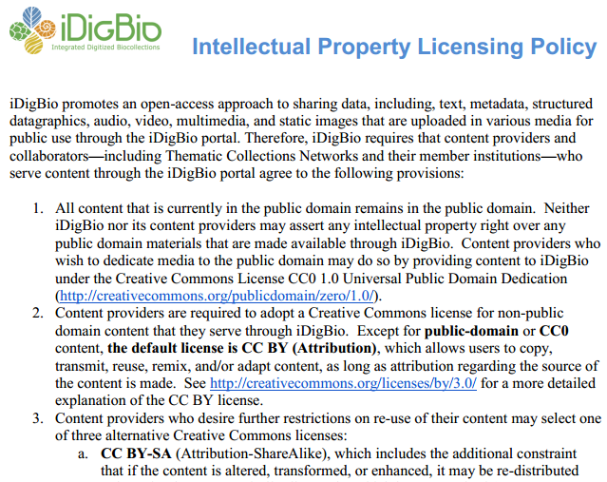
iDigBio.org
News
Events
Forums
Documents
Links
Data
portal
Working
groups

Slide 8
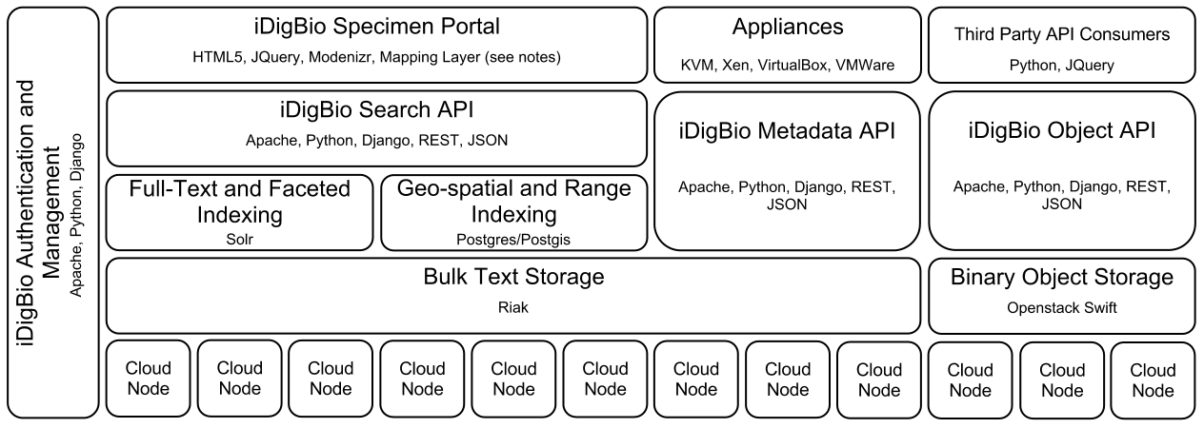
Building the iDigBio Cloud
Useful services/APIs (programmatic and web-based)
Scalable object storage and information processing
Digitization-oriented virtual appliances
Standards, proven solutions and software reuse if possible
Input from stakeholders (surveys, summit, workshops, …)
Needs: storage, server hosting, data feedback transformations …

Slide 9
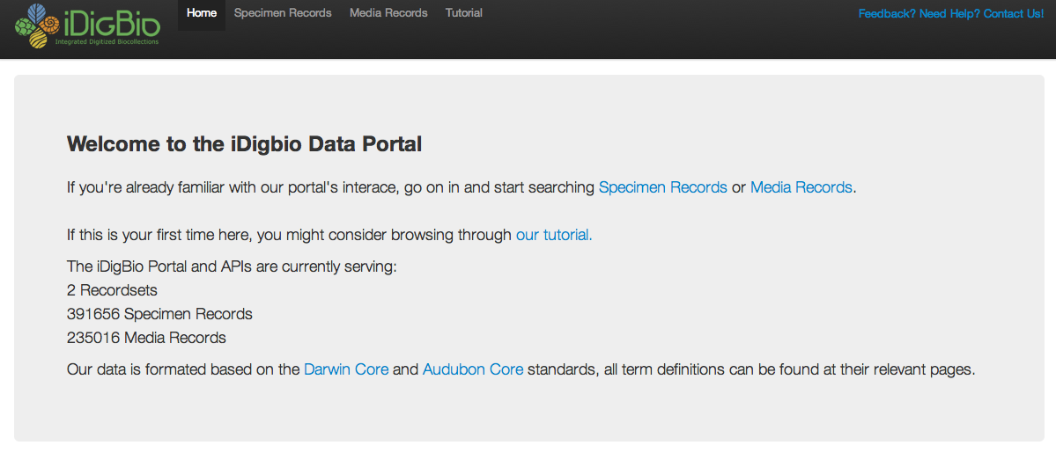
iDigBio data portal v0 at work

Slide 10
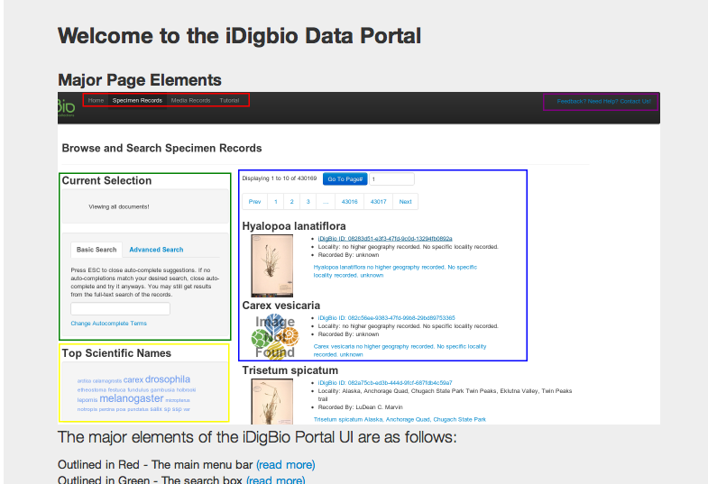
iDigBio Data Portal: Tutorial

Slide 11
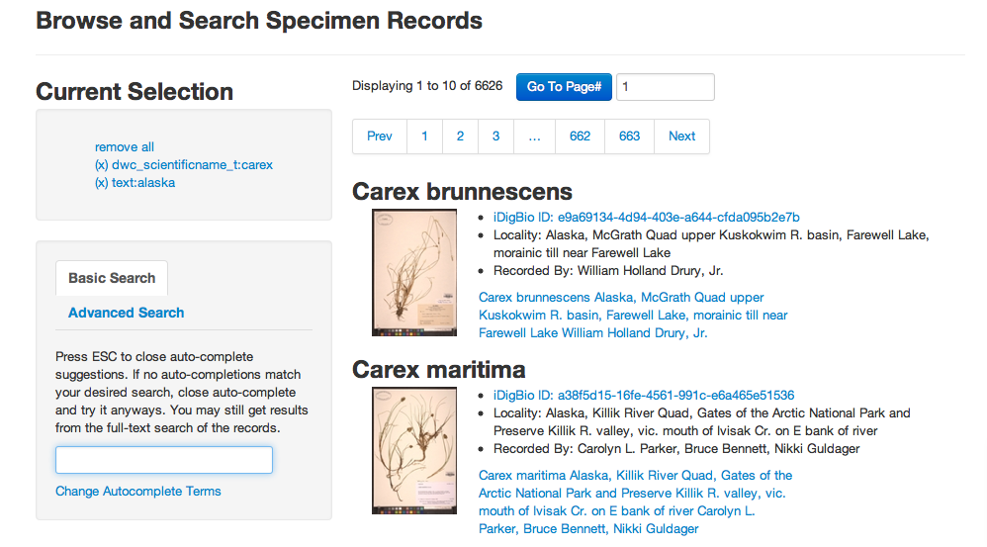
iDigBio data portal v0: search

Slide 12
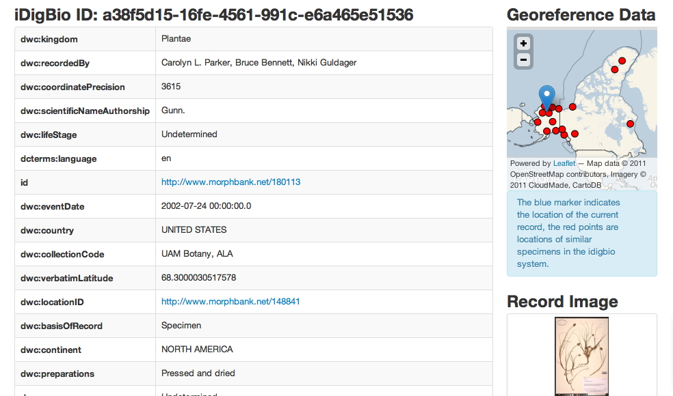
iDigBio data portal v0: record info

Slide 13
Storage hosting
“… able to facilitate storage of images on a case-by-case basis.”
“iDigBio currently does not provide archival storage, and hosting of images in iDigBio should not be seen as such.”
currently approximately 30 TB space committed to storage for the dissemination of images and derivatives produced by TCNs:
North American Lichens and Bryophytes
The Macrofungi Collection Consortium
Plants, Herbivores, and Parasitoids
If you would like iDigBio to store and disseminate your TCN data as well, please contact us.
iDigBio also provides limited storage space along with its hosting services, this space currently totals approximately 8TB of storage.
Notes:
iDigBio currently has approximately 30 TB space committed to storage for the disemenation of images and derivatives produced by the following TCNs:
LBCC TCN
MaCC TCN
TTD TCN
If you would like iDigBio to store and disseminate your TCN data as well, please contact us.
iDigBio also provides limited storage space along with its hosting services, this space currently totals approximately 8TB of storage.

Slide 14
Appliances, Virtual Private Servers
iDigBio packages and distributes pre-configured software tools and environments as software “appliances”
Deployment in end-user or in a hosted server environment
iDigBio cloud hosts virtual private servers exposing services to the bio-collections community
Proposal requests through iDigBio portal interface
Virtual private servers on iDigBio cloud:
Symbiota, FilteredPush, VertNet, Biogeomancer
Virtual appliances
Under development: Media ingestion; augmenting-OCR workshop and hack-a-thon
Community interactions: Image-to-record services (OCR, NLP, duplicate discovery, workflow), Kepler Kurator, Specify

Slide 15
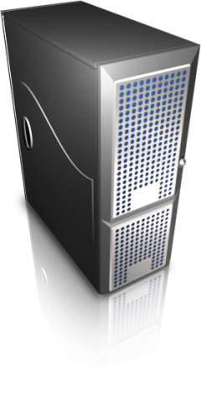

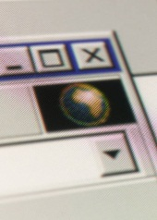
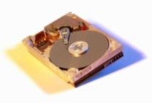
Short term
Facilitate data ingestion, interface with iDigBio
Ingestion
appliance
Web-based UI
Web
server
Cloud
client
Batch upload,
Cloud APIs
File interface
/1/100.tif GUID1
/1/101.tif GUID2
iDigBio object
Storage cloud
(Swift)
Images captured
(e.g. HD/flash media)
/images/1/100.tif
/1/101.tif
/2/200.tif
…
Notes:
This overviews where we are in the data ingestion appliance
This is an example of an appliance that addresses a need identified internally – ingesting image files into the iDigBio cloud in a simple, reliable manner
A goal here is to streamline the process of consolidating images into a repository that is Web accessible. For instance, a TCN with multiple institutions can use this mechanism to ingest images in a distributed fashion, then later post-process the image to extract metadata, OCR, etc – rather than expecting TCNs to coordinate the exchange of these images, they get stored in iDigBio cloud
The approach here is akin to synchronizing media to storage; media here would be typically images captured using a camera/scanner.
The user interface is Web-based, so it’s accessible from a browser
An embedded web server is in the appliance and take user requests to specify a folder that are to be uploaded
The appliance takes this request and becomes responsible for locating and uploading images, interacting with the iDigBio API, dealing with failures, and providing unique URL identifiers that can be used to reference the uploaded image(s) (and can be used as GUIDs)

Slide 16
Data Ingestion Tool Demo
Initial Setup

Slide 17
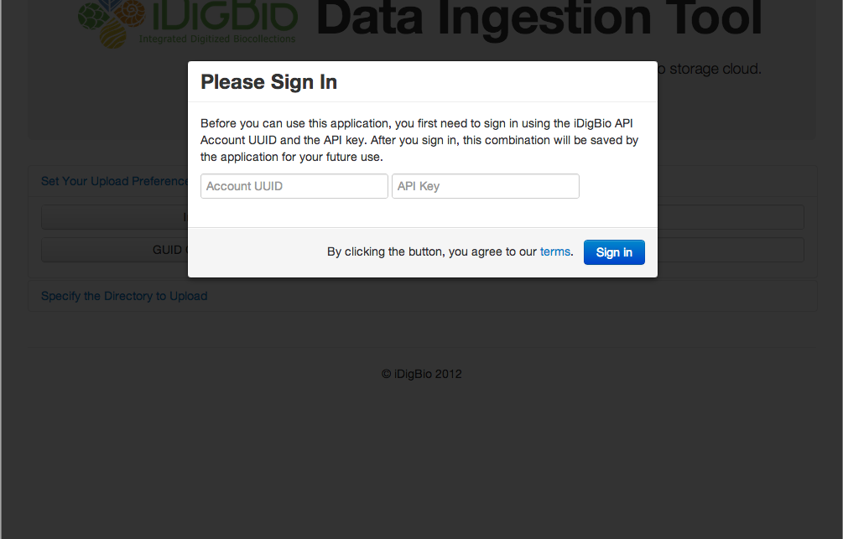
Initial Screen – Sign In
Notes:
The user needs to sign in to use the application.

Slide 18
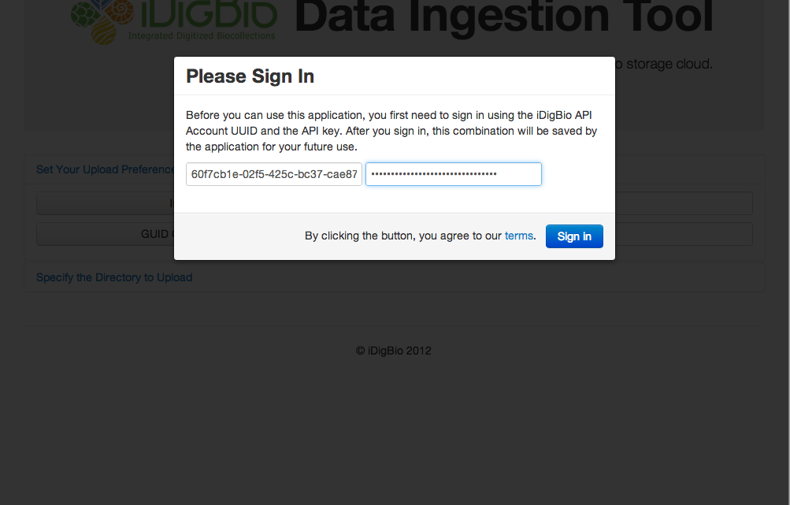
Fill out Sign In Form
Notes:
Account ID & API Key combination is provided by iDigBio

Slide 19
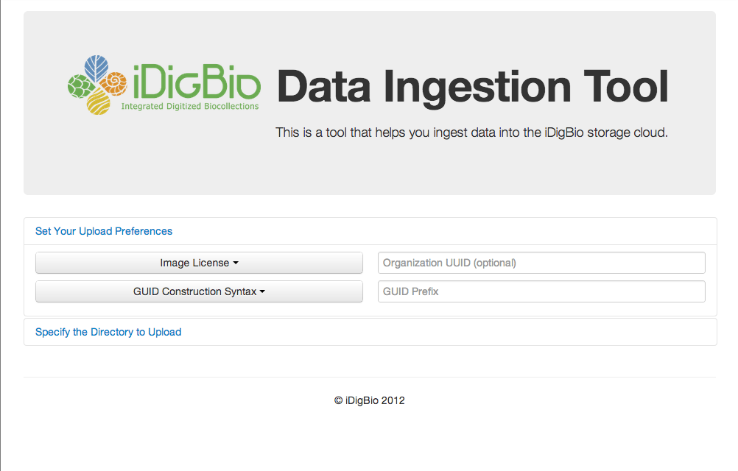
Settings Pane After Signing In
Notes:
If the settings have not been configured (e.g. in the first use of the application) the user will first be directed to the setting pane.
If settings are configured already, the user goes directly to the uploader pane.

Slide 20
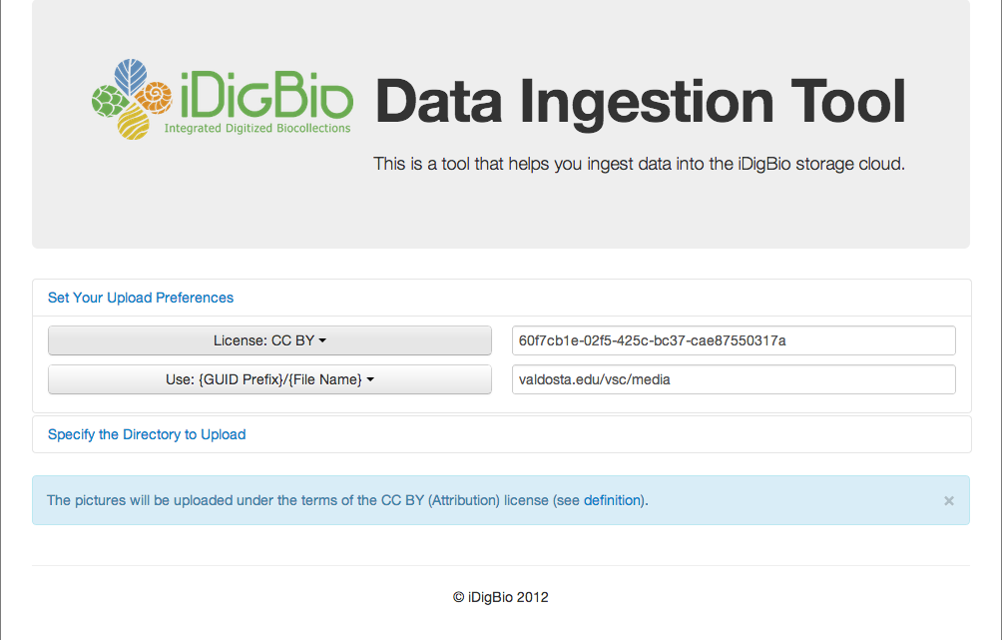
Fill Out Settings

Slide 21
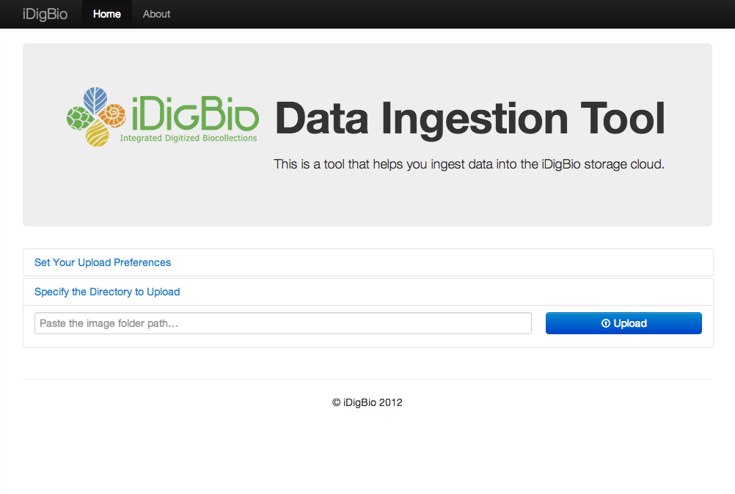
Move Next to Uploader Pane

Slide 22
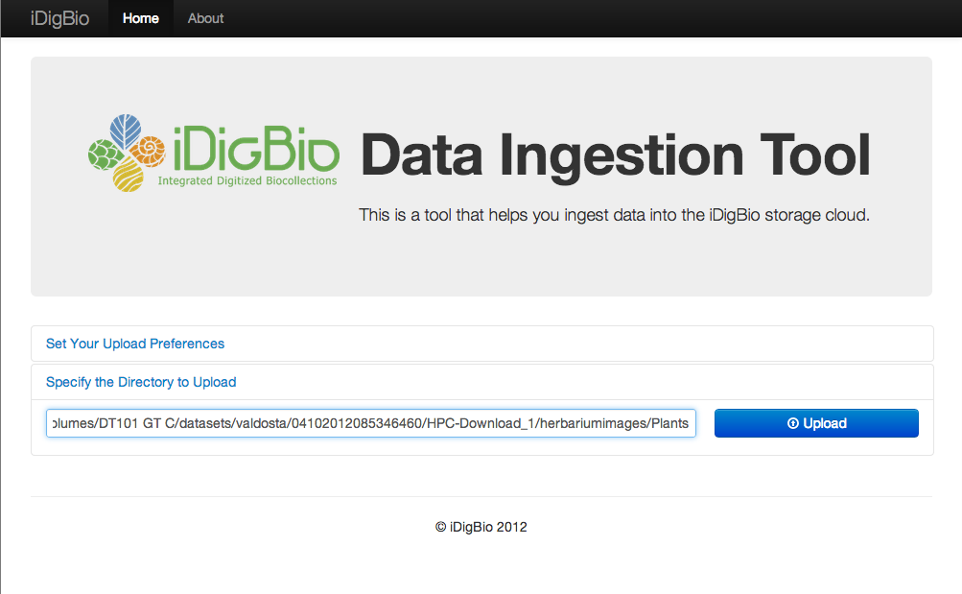
Copy and Paste Path, Upload
Notes:
User clicks “Upload” button.

Slide 23
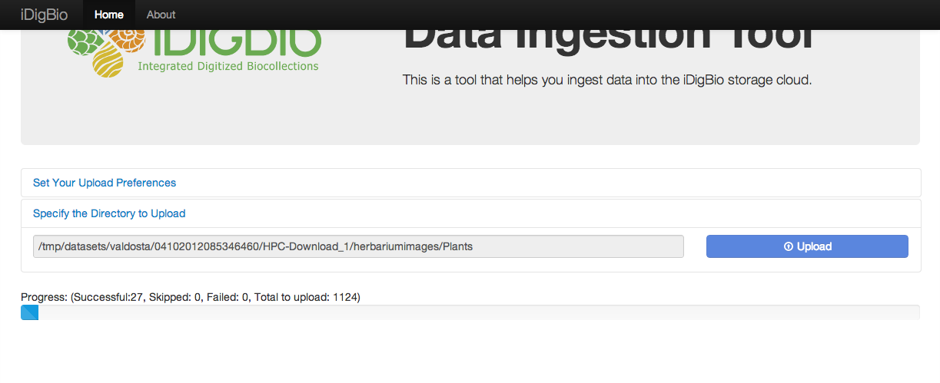
Upload Started
Notes:
The progress bar shows the percentage of the pictures that the tool has attempted to upload.

Slide 24
Data Ingestion Tool Demo
Case 1: Ingestion Successful on the First Attempt

Slide 25
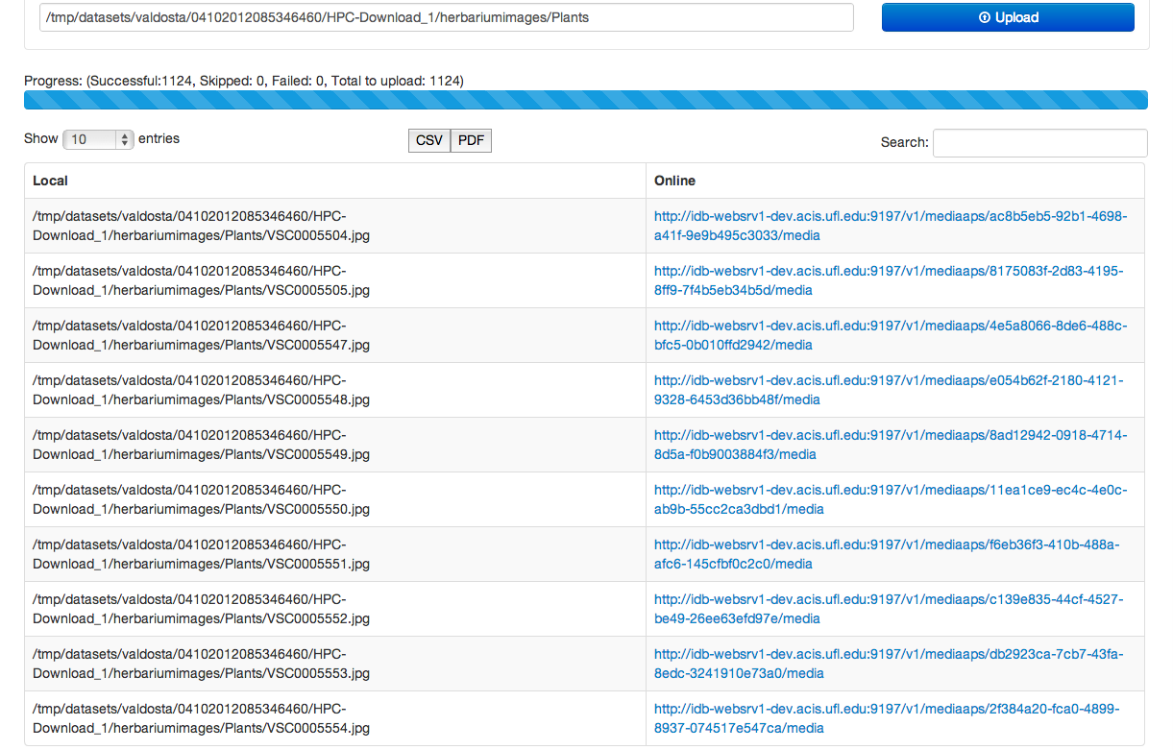
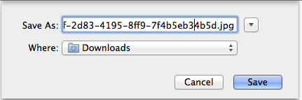
Upload Finishes Successfully
Notes:
If everything goes well, the batch upload finishes with all images successfully uploaded.
There can be temporary failures that have been recovered by several retries on each image, each retry after a exponential back-off.
Click ‘CSV’ or ‘PDF’ to export the entire mapping table.
Click the link to download the image.

Slide 26
Data Ingestion Tool Demo
Case 2: Ingestion Successful After Several Attempts

Slide 27
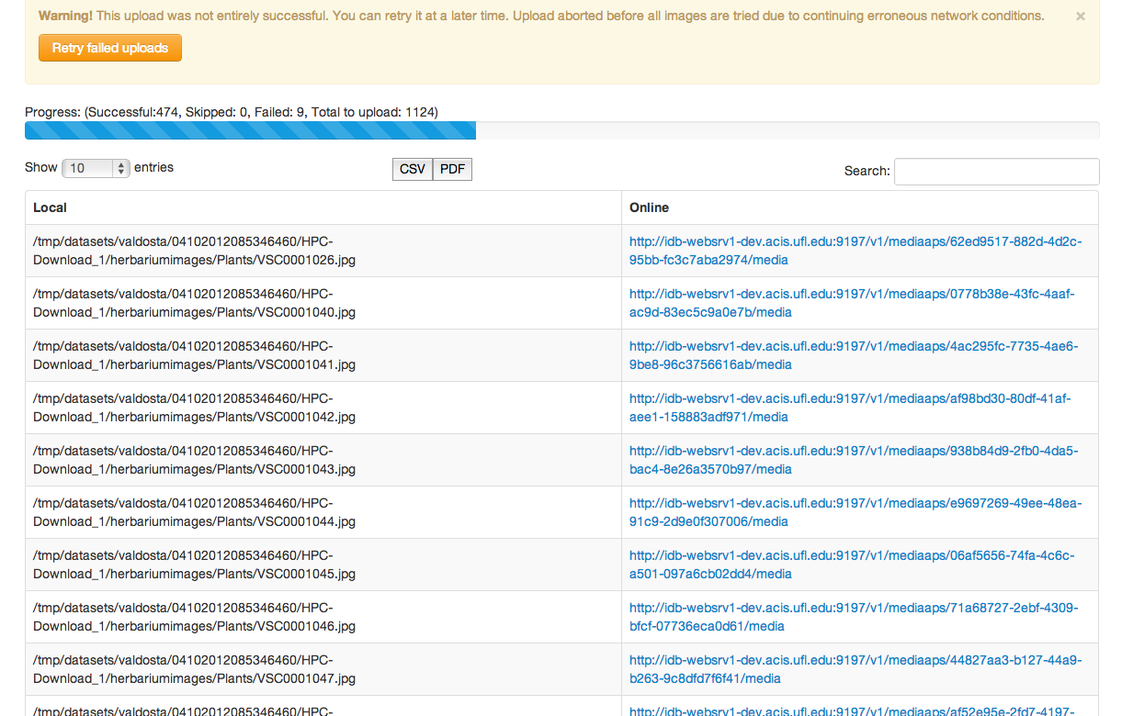
Network Failed - Upload Aborted
Notes:
Batch upload failed due to continuing network failure
- In this case, ACIS VPN disconnected.
- Upload is aborted after 9 consecutive failed images.

Slide 28
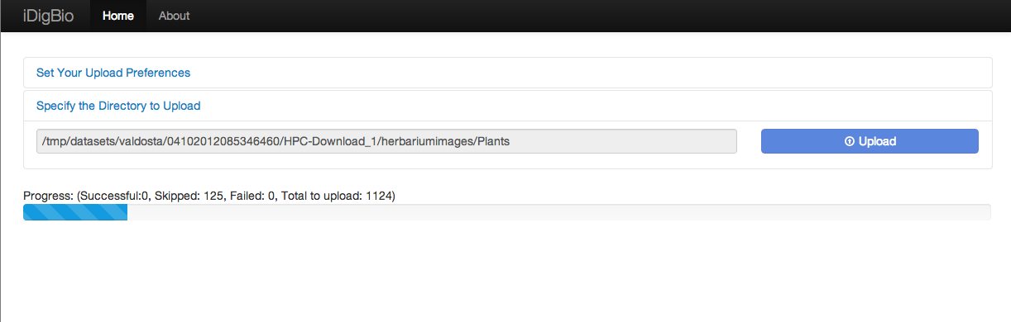
Upload Resumes
Notes:
Batch upload resumes after the user clicks the ‘retry’ button.
- The directory is rescanned for old and potentially new images.
- Images already uploaded are skipped.

Slide 29
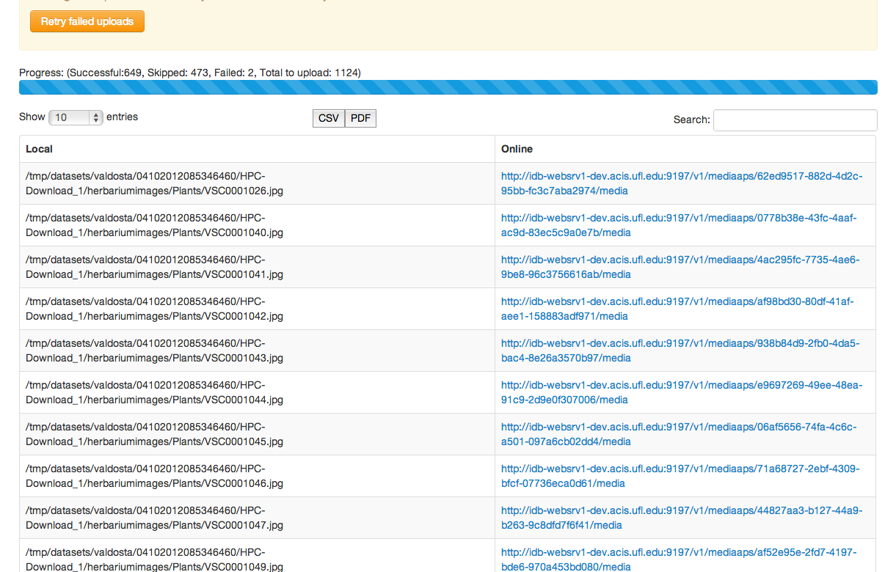
Upload Finished with Some Errors
Notes:
This time there was no major network errors but,
- 2 images still failed even after multiple retries.

Slide 30
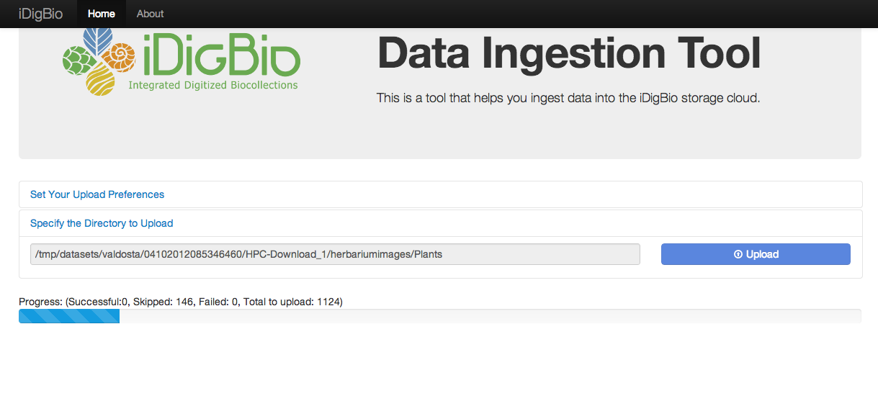
Resume Again
Notes:
Resume again.

Slide 31
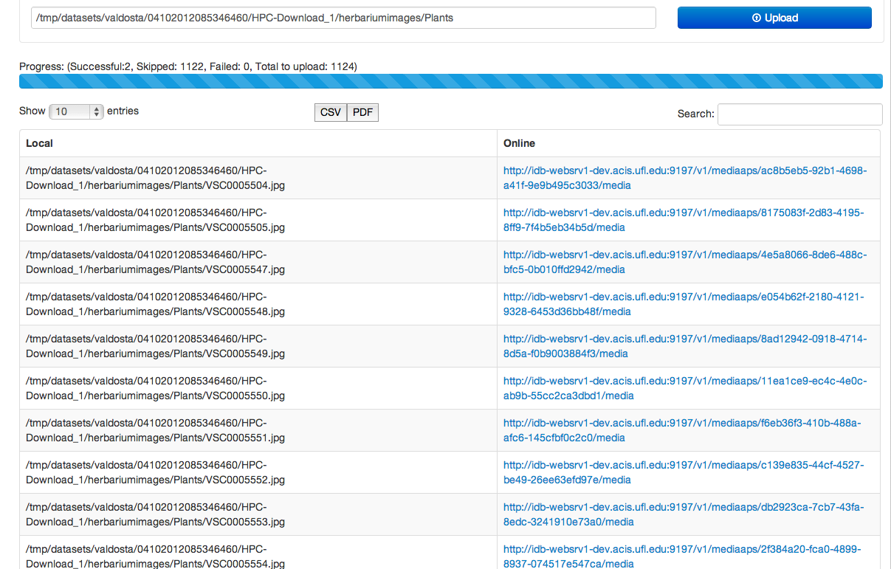
Now Entire Batch is Successful
Notes:
All images are successfully uploaded.

Slide 32
Summary
iDigBio cloud
Service-oriented, standards-based, focused on ADBC needs
Scalable data management and information processing using standard interfaces, data formats, protocols, tools
Toolboxes as appliances
Evolving collection of community-selected tools
Built-in interfaces for effortless iDigBio integration
Embed best practices and standards in biocollections work
After the first year we have functional web site, data portal, storage and server hosting services
Ingestion appliances and ingestion APIs for images and data soon available
For feedback: fortes@ufl.edu and “Contacts” at idigbio.org

Slide 33
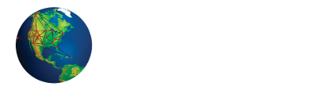
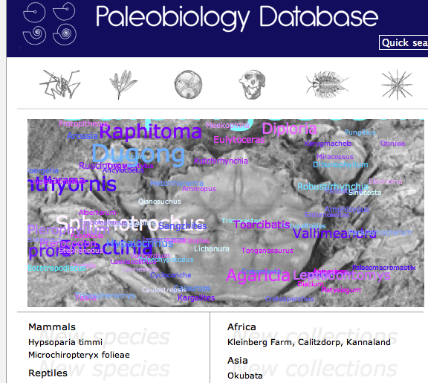
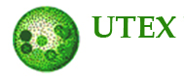

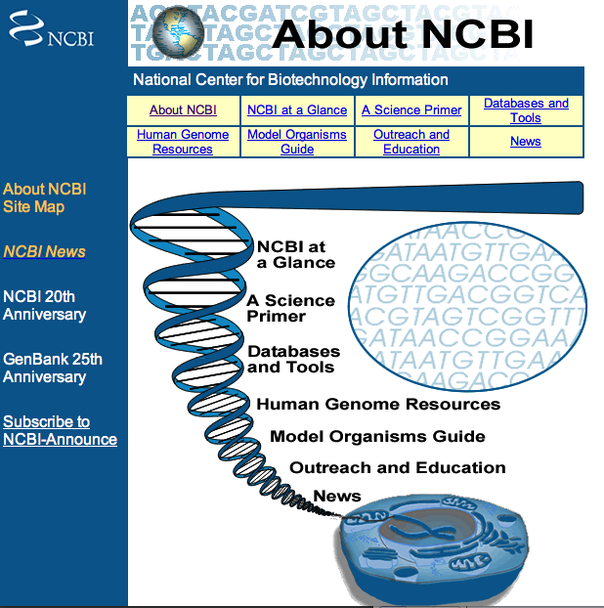
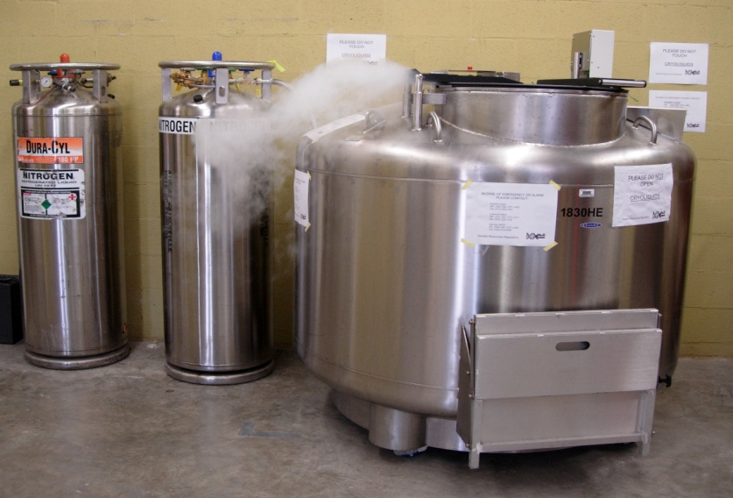
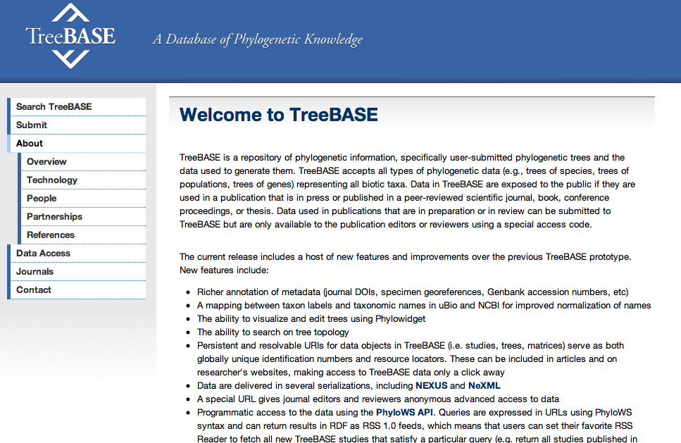
Linking Collections to…
Ecology
Paleontology
Genomics
Living Collections
Other repositories
PRAGMA activities

Slide 34

Acknowledgments
National Science Foundation
Judith Skog and Anne Maglia
iDigBio IT team at U. of Florida
Renato Figueiredo & Andrea Matsunaga, Senior Personnel
Alex Thompson, Kevin Love & Matt Collins, IT Experts
Jiangyan Xu, Graduate student
iDigBio IT team at Florida State U.
Greg Riccardi, Director for Informatics
Austin Mast, Senior Personnel
Gil Nelson & Deb Paul, Digitization Specialists
Guillaume Pierre, IT expert

